Slide 1




Talent Factory
Unique Journeys, One Goal
Error 404!
arkx.group

Slide 2










Team Members
Talent Factory
Mohamed Benlahbib
Zakaria Errahil
Aymane Farrajallah
Souhail Faraji
Ismaiyl Oumhend
arkx.group
1
Notes:
1.7.2013
‹#›

Slide 3


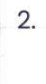

Talent Factory
Plan
arkx.group
2
Notes:
1.7.2013
‹#›

Slide 4
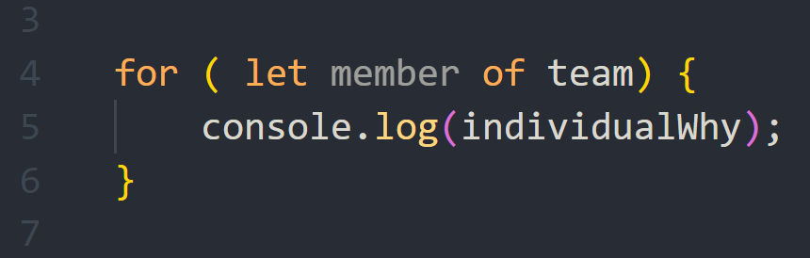

Talent Factory
Individual Why(s)
arkx.group
3
Notes:
1.7.2013
‹#›

Slide 5


Talent Factory
Skill Development: a unanimous desire to enhance both soft and technical skills.
Community and Networking: We see the bootcamp as an immense opportunity to connect and join a dynamic network of developers.
Common Why(s)
Real-world Impact: A shared aspiration to apply newly acquired skills to real challenges and projects.
Transition to Professional World: gaining practical experience, and transitioning effectively to the professional world.
Unique Journeys, One Goal
arkx.group
4
Notes:
1.7.2013
‹#›

Slide 6
Talent Factory
Mohamed Benlahbib
Zakaria Errahil
Aymane Farrajallah
Souhail Faraji
Ismaiyl Oumhend
arkx.group
5
Notes:
1.7.2013
‹#›

Slide 7

Talent Factory
Thank you. 🙏🚀
arkx.group
6
Notes:
1.7.2013
‹#›

